Slide 1
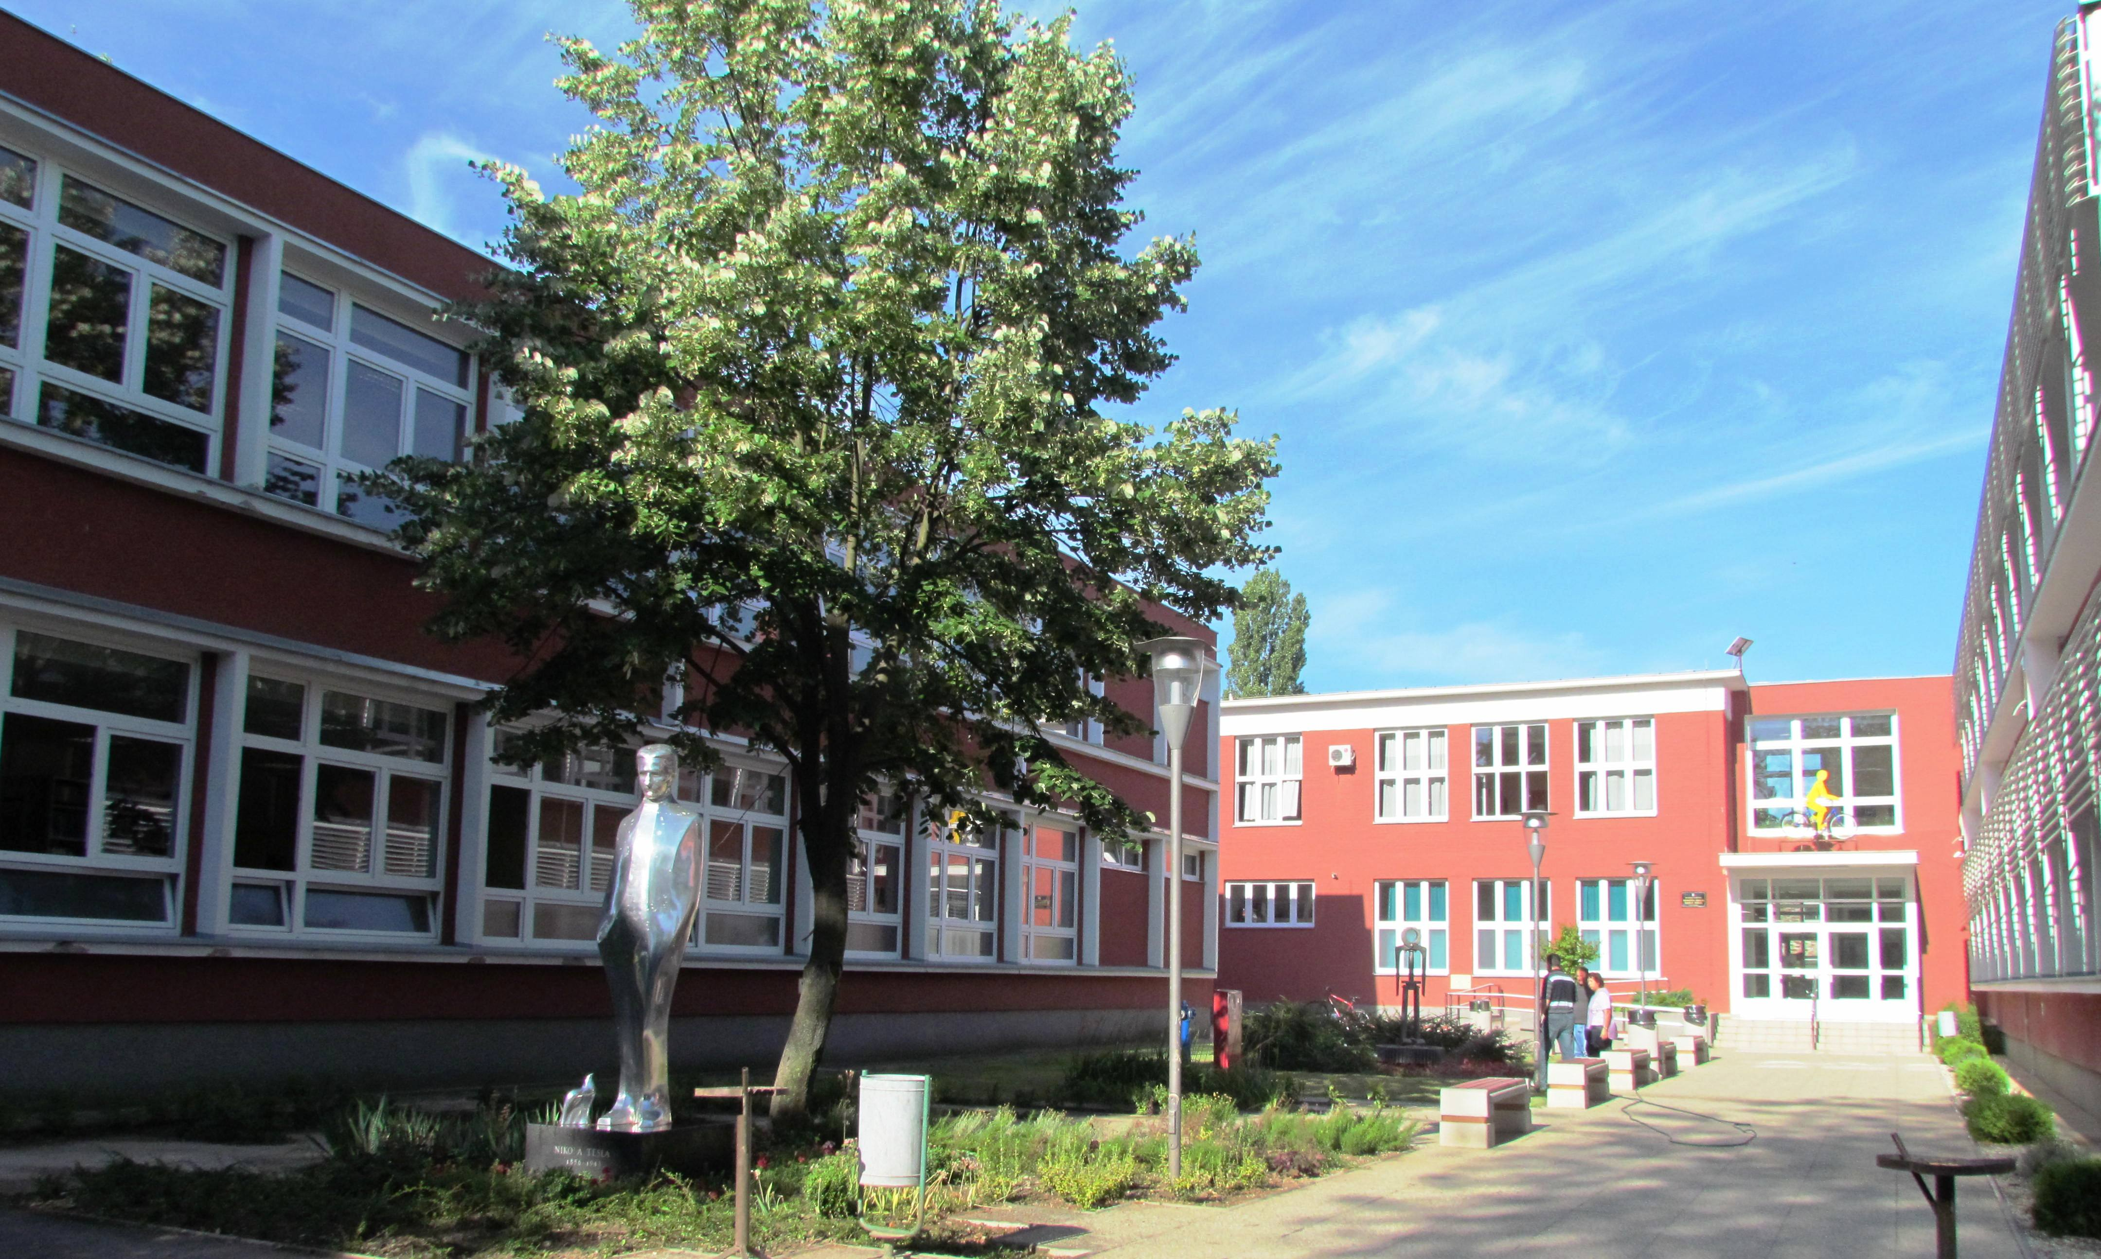
Technical school of Nikola Tesla
Vukovar
3.2 TR i 2.bTR 2021/2022
Tanja Stakić

Slide 2
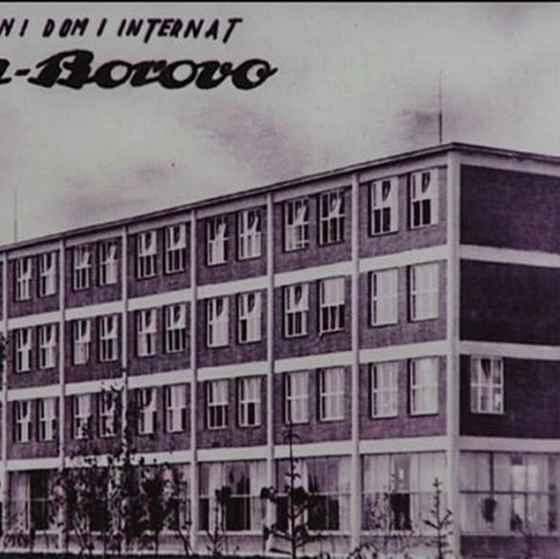
History of Bata and Borovo
Borovo was founded by the Czech industrialist Jan Bata, the owner of the Bata shoe company, in 1931, when he built an entire neighbourhood for company’s workers.
With the construction of the factory, a workers’ settlement, the so-called “Bata-ville”, was also established.

Slide 3
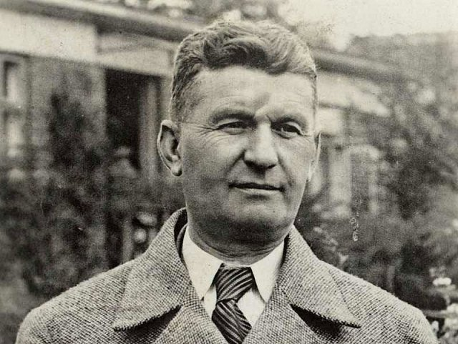
History of Bata and Borovo
New roads were built, as well as houses, artesian wells, and two boarding schools. Workers’ housing of the highest standard was constructed, along with a workers’ restaurant in 1932, a sports stadium in 1933, a railway station in 1934, a cinema and an elementary school in 1935, a community centre in 1936, and Bata’s trade school in 1937.
The town also had its own airport, clinic, kindergarten, facilities for sports and culture, green areas and parks, shops, bars, a department store, a library, and a public swimming pool.
Tomaš Bata

Slide 4
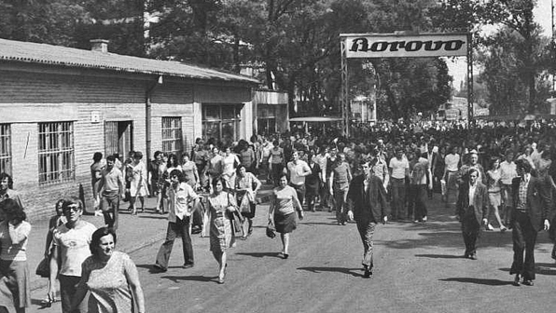
History of Bata and Borovo
In its glory days, it employed 23,000 people and each year produced 23 million pairs of footwear, 580,000 car tyres, and 12,500 tons of technical rubber products.

Slide 5
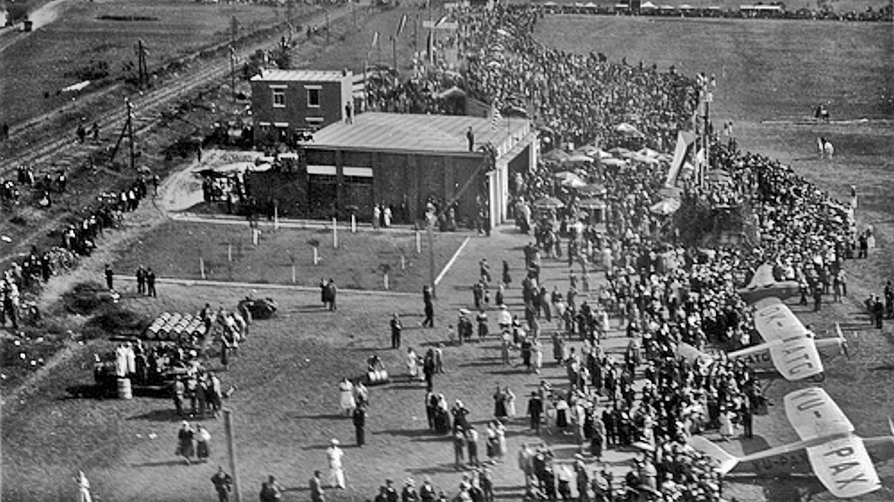
History of Bata and Borovo
It became a symbol of production and prosperity in Vukovar, which was then a major hub for industry and employment.
Borovo shoes and its popular brands, such as Startas, were worn by generations of people across Yugoslavia.

Slide 6
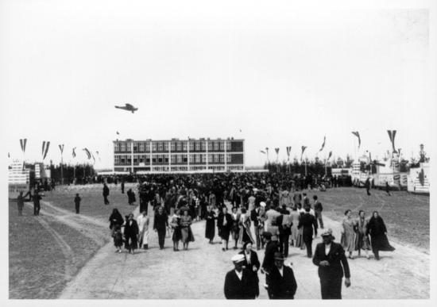
History of our school
According to the first written documents of our school (October 11, 1936), Baťa approved, at his own expense, the organisation of a school for students and assistants in Borovo naselje.
The school was called the Vocational Extension School of the Craft Department, and it began operating in the 1937/1938 school year.
It was a boarding school. The schooling lasted three years, and the “young husbands and wives,” as they were called, worked in the factory at the same time.

Slide 7
History of our school
In 1940, Baťa requested the opening of the Secondary School of Crafts and Industry. The request was approved in June 1940, and the school began operating in the 1940/1941 school year.
After World War II, the school was renamed the State Industrial School (known as DIŠ, as some people still call our school). It provided training in rubber processing, shoemaking, and mechanical engineering.

Slide 8
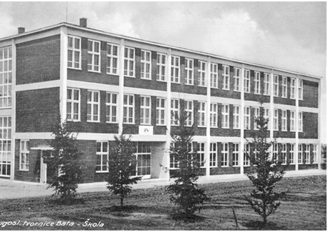
History of our school
In the 1940s, the school was attended by 400 students, and in the 1950s that number increased to 1,800.
Since 1962, the school has been called the Footwear and Rubber Technical School.
In the 1960s, more than 3,800 students attended the school.

Slide 9
History of our school
In the 1970s, the school was attended by over 4,500 students. A new occupation, TV mechanic, was introduced. During this period, the school also began educating students with mild intellectual disabilities. They were trained to become auxiliary workers (in the factory) and were immediately employed there.
Today, we often talk about the need for integration and support for people with intellectual disabilities, but our school addressed this issue more than 40 years ago.

Slide 10
History of our school
In 1973, the school changed its name to the Edvard Kardelj Centre for Education and Oriented Education.
Official documents from that period show that our school opened departments in Bosnia and Herzegovina, Serbia, and Donji Miholjac. In these departments, our professors worked as guest lecturers.
In the 1980s, the school did not change its name but had a record number of students — over 7,800.

Slide 11
History of our school
In the 1990s, that number was reduced to 4,000. The school changed its name from Borovo Technical School to Vukovar Secondary School.
During that decade, the rubber and footwear departments were shut down. There were no interested students, and the factory no longer needed new staff. An electrotechnical department was opened and soon became dominant.

Slide 12
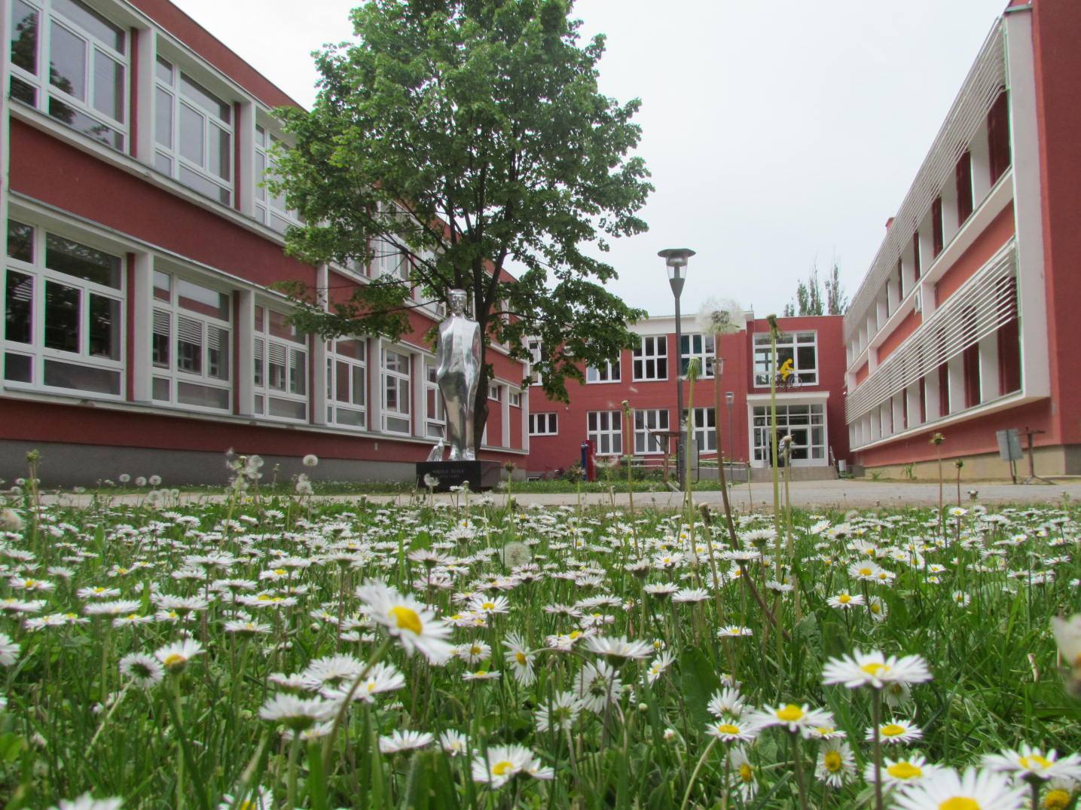
History of our school
In 2005, the school was renamed the Technical School Nikola Tesla Vukovar.

Slide 13
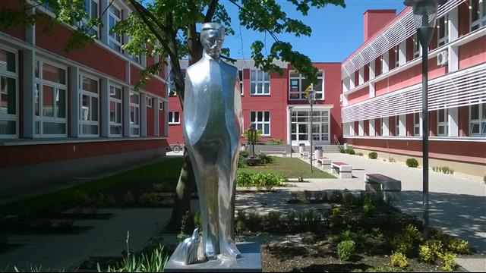
THE SCHOOL TODAY
Classes in our school are bilingual. Students can attend classes in the Croatian language and Latin script or the Serbian language and Cyrillic script.
What sets us apart from other bilingual schools is mutual tolerance and cooperation.
The school has 400 students, some of whom attend four-year programmes and some three-year programmes.

Slide 14

FOUR-YEAR PROGRAMMES ARE:
Environmental Technician
Electrical Technician
Computer Technician
Mechanical Engineering
Computer Technician

Slide 15
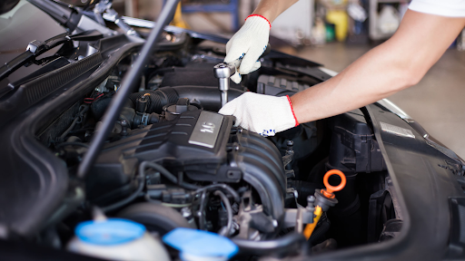
THREE-YEAR PROGRAMMES ARE
car mechanic
automotive electricians
car bodyworker
gas installer
plumber

Slide 16
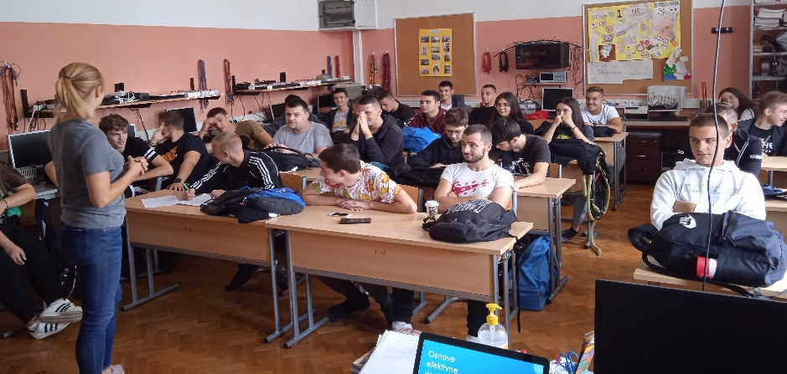
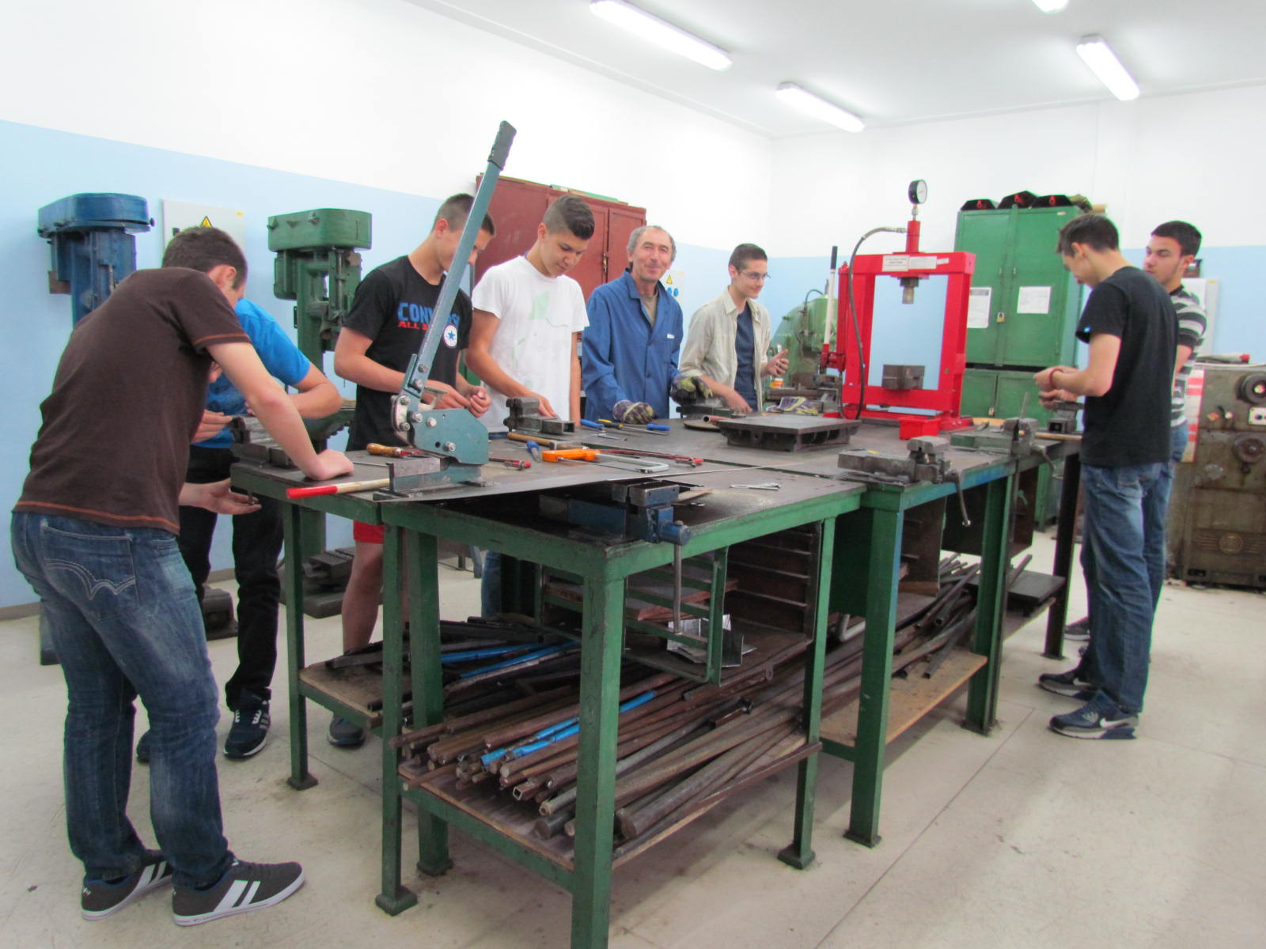
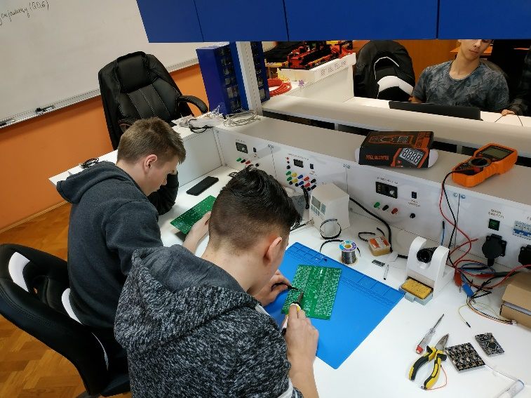
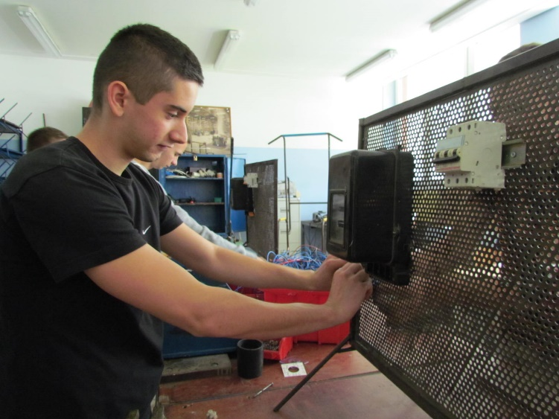
Our students achieve excellent results in national competitions.
In addition, students together with their teachers represent the school in various projects across Europe.
Students who wish to continue their education at university after finishing our school must pass the State Matura exam.
Our students are very successful in this exam.

Slide 17
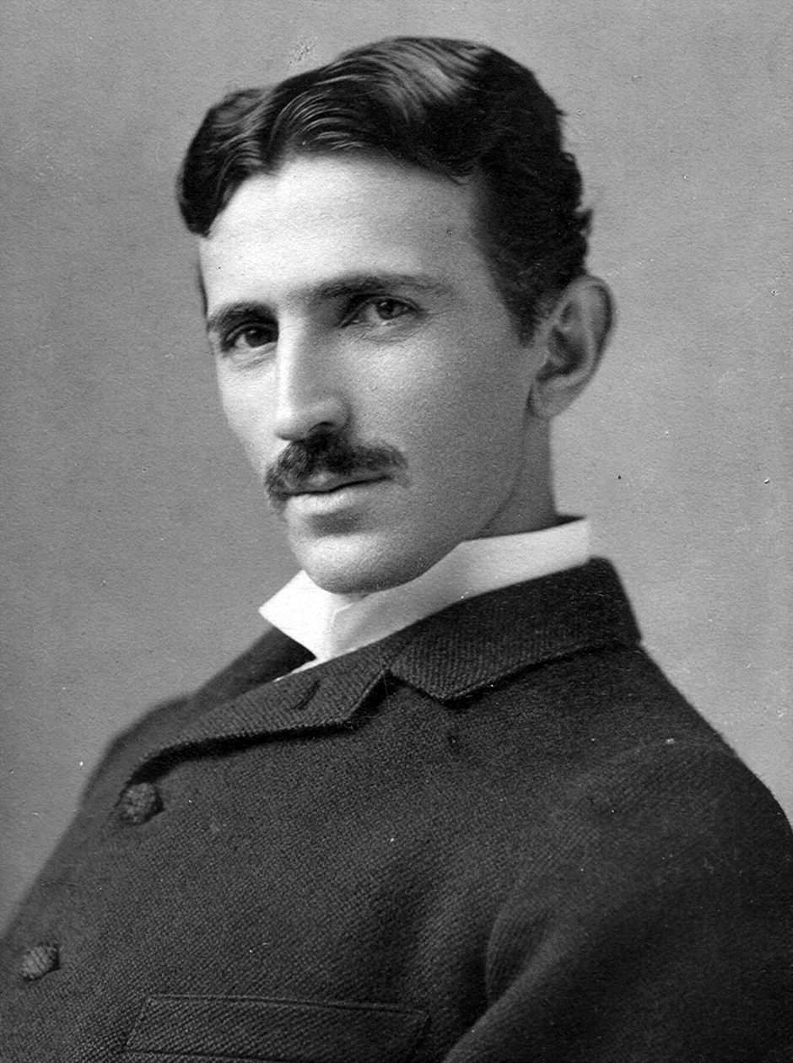
Nikola Tesla
Nikola Tesla was born in 1856 in Smiljan, Croatia, which at that time was part of the Austro-Hungarian Empire.

Slide 18
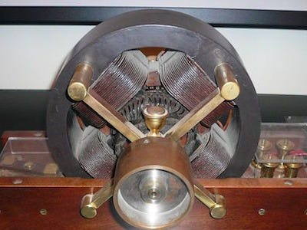
Nikola Tesla
In 1882, while studying engineering in Graz and philosophy at the University of Prague, Tesla drew the first sketches of his idea for an electromagnetic motor.
His first job involved working with DC power plants for ConEdison, which eventually led to his immigration to the United States in 1884.

Slide 19
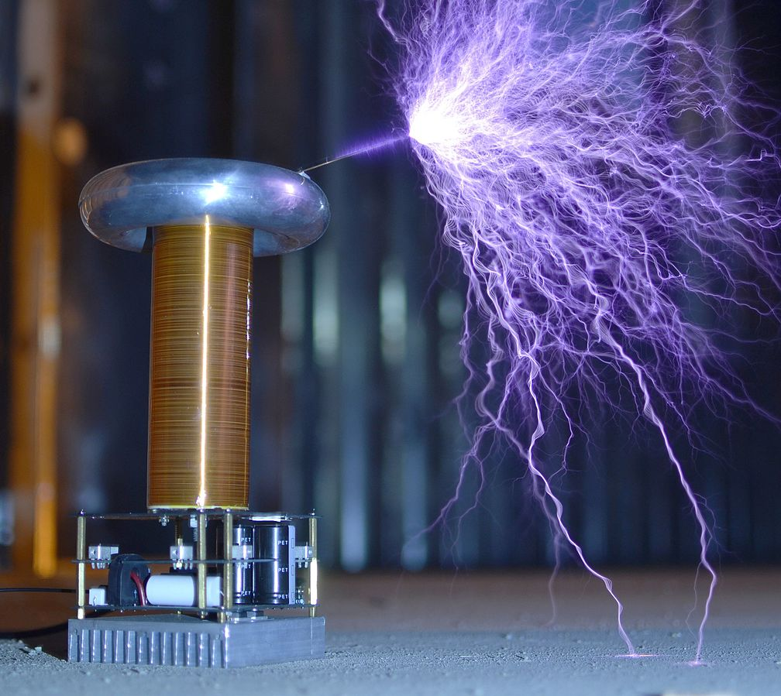
Tesla’s inventions include:
AC Power (alternating current)
Tesla Coil
Magnifying Transmitter
Tesla Turbine
Shadowgraph
Radio
Neon Lamp
Hydroelectric Power
Induction Motor
Radio Controlled Boat

Slide 20
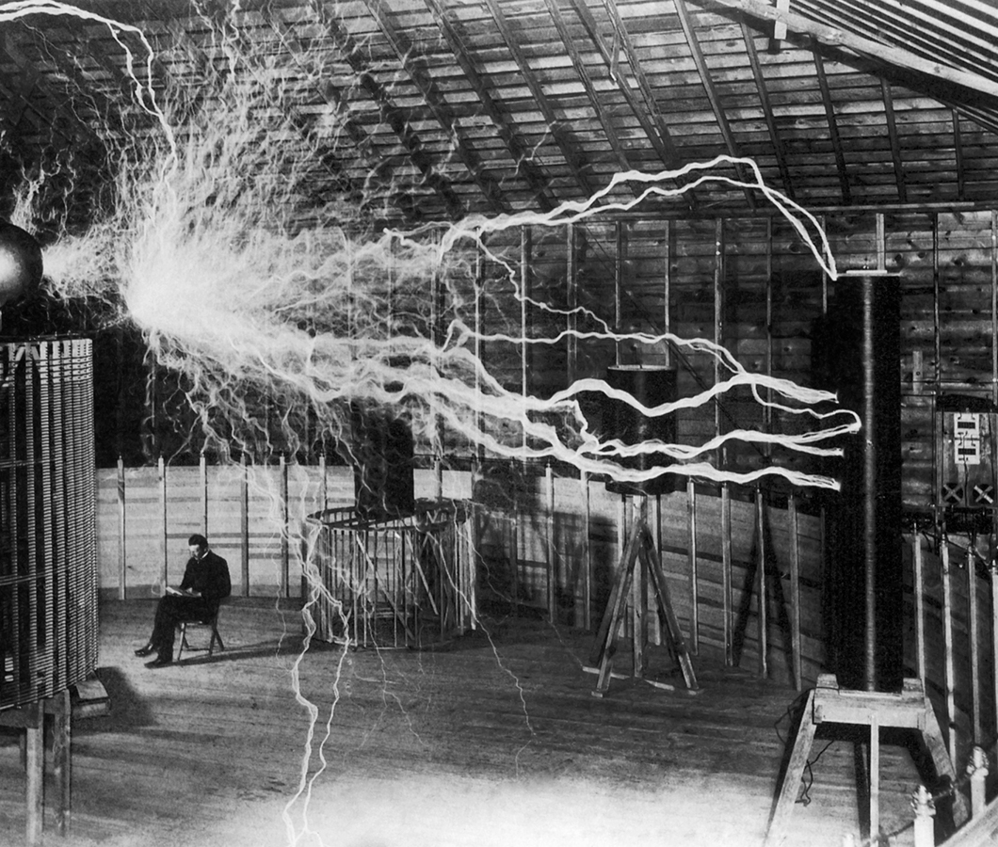
Tesla died on January 7, 1943.
Later that year, the U.S. Supreme Court voided four of Marconi’s key patents, belatedly acknowledging Tesla’s innovations in radio.
The AC system he championed and improved remains the global standard for power transmission.

Slide 21
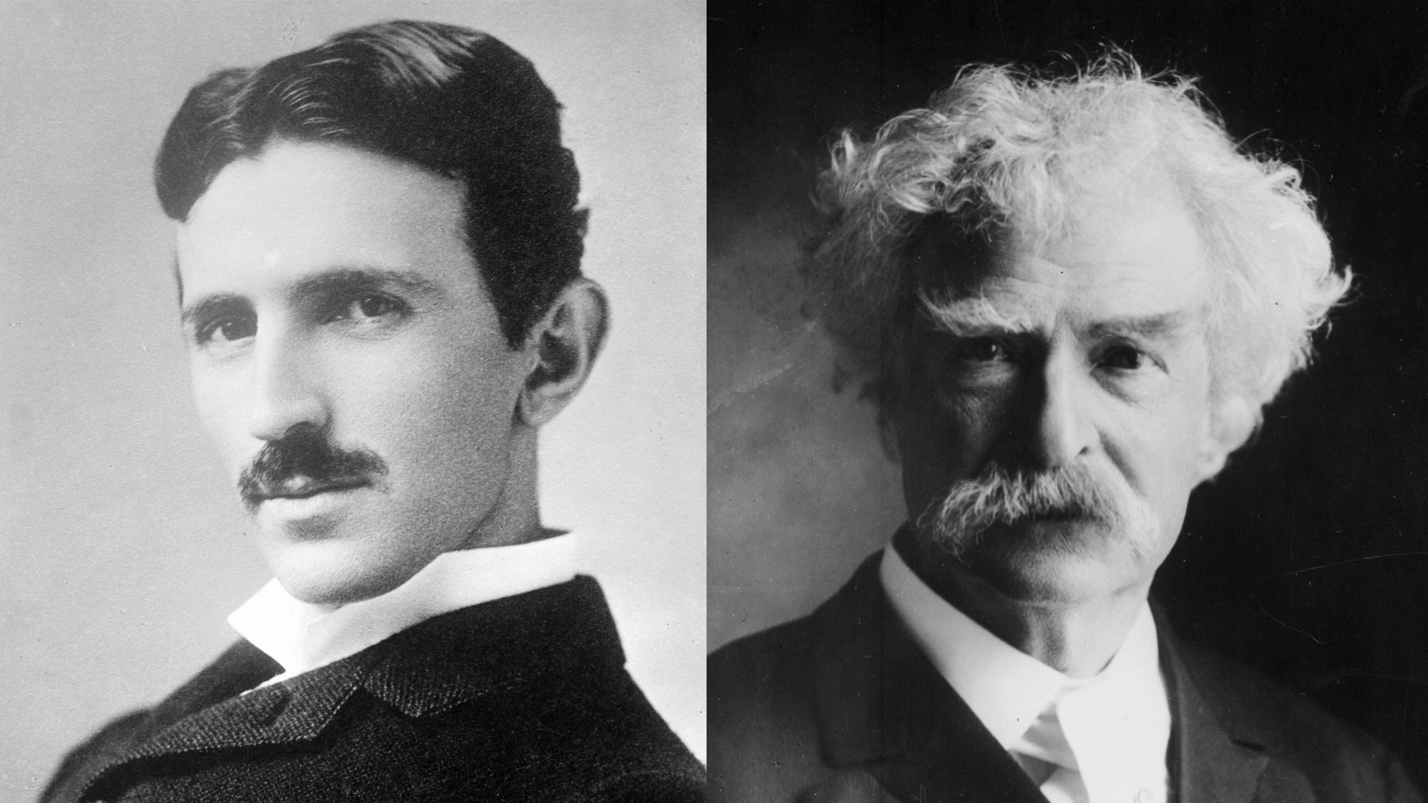
Did you know?
During the 1890s, Mark Twain formed a friendship with the inventor Nikola Tesla. Twain often visited him in his laboratory. In 1894, Tesla photographed the famous American writer in one of the first photographs ever taken using phosphorescent light.

Slide 22

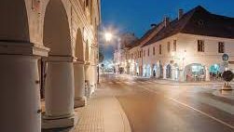
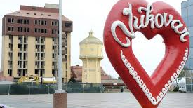
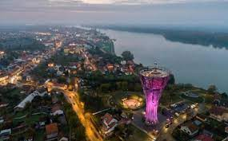
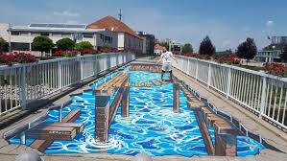
Vukovar

